Slide 1
DENSITY BASED TRAFFIC LIGHT CONTROL SYSTEM
By Team member-
Paras Jain
Gagan Dhami
Adesh Singh
Abhishek Pandey
3rd year CSE
MGM COLLEGE OF ENGINEERING AND TECHNOLOGY COET, NOIDA

Slide 2
Contents
PROJECT OVERVIEW
Introduction
Objective
Project Details
PROJECT Idea
Working
Flow Chart
Circuit Diagram
Components Requirements
Ultrasonic Sensor
LEDs
CONCLUSION
Project Conclusion
BIBILIOGRAPHY
References

Slide 3
Introduction
In modern life, we have to face with many problems one of which is traffic congestion becoming more serious day after day. The major cause leading to traffic congestion is the high number of vehicles which were caused by the population and the development of the economy. Due to the massive growth in urbanization and traffic congestion, an automatically based traffic light controller is needed to reduce the traffic delay and travel time, especially in developing countries. Traffic congestion is now considered to be one of the biggest problems in urban areas. Traffic problems will be also much more widely increasing as an expected result of the growing number of transportation means and the current low-quality infrastructure of the roads. This idea of controlling the traffic light efficiently in real-time.

Slide 4
Objective
The main objective of this project is, if there will be low traffic on the other signal, time allocated for green light for that signal will be reduced. The system will skip that signal and will move on the next one.

Slide 5
Project Details / Working
If there is traffic at all the signals, then the system will work normally by controlling the signals one by one.
If there is no or less traffic near a signal, then the system will reduce timer signal and then will move on to the next one. For example, if there is less vehicle density at signal 2, 3 and currently the system is allowing vehicles at signal 1 to pass. Then after signal 1, the system will reduce the signal timer and then pass to signal 4.
If there is no traffic at all the 4 signals, system will stop at the current signal and will only move on the next signal if there will be traffic at any other signal.

Slide 6
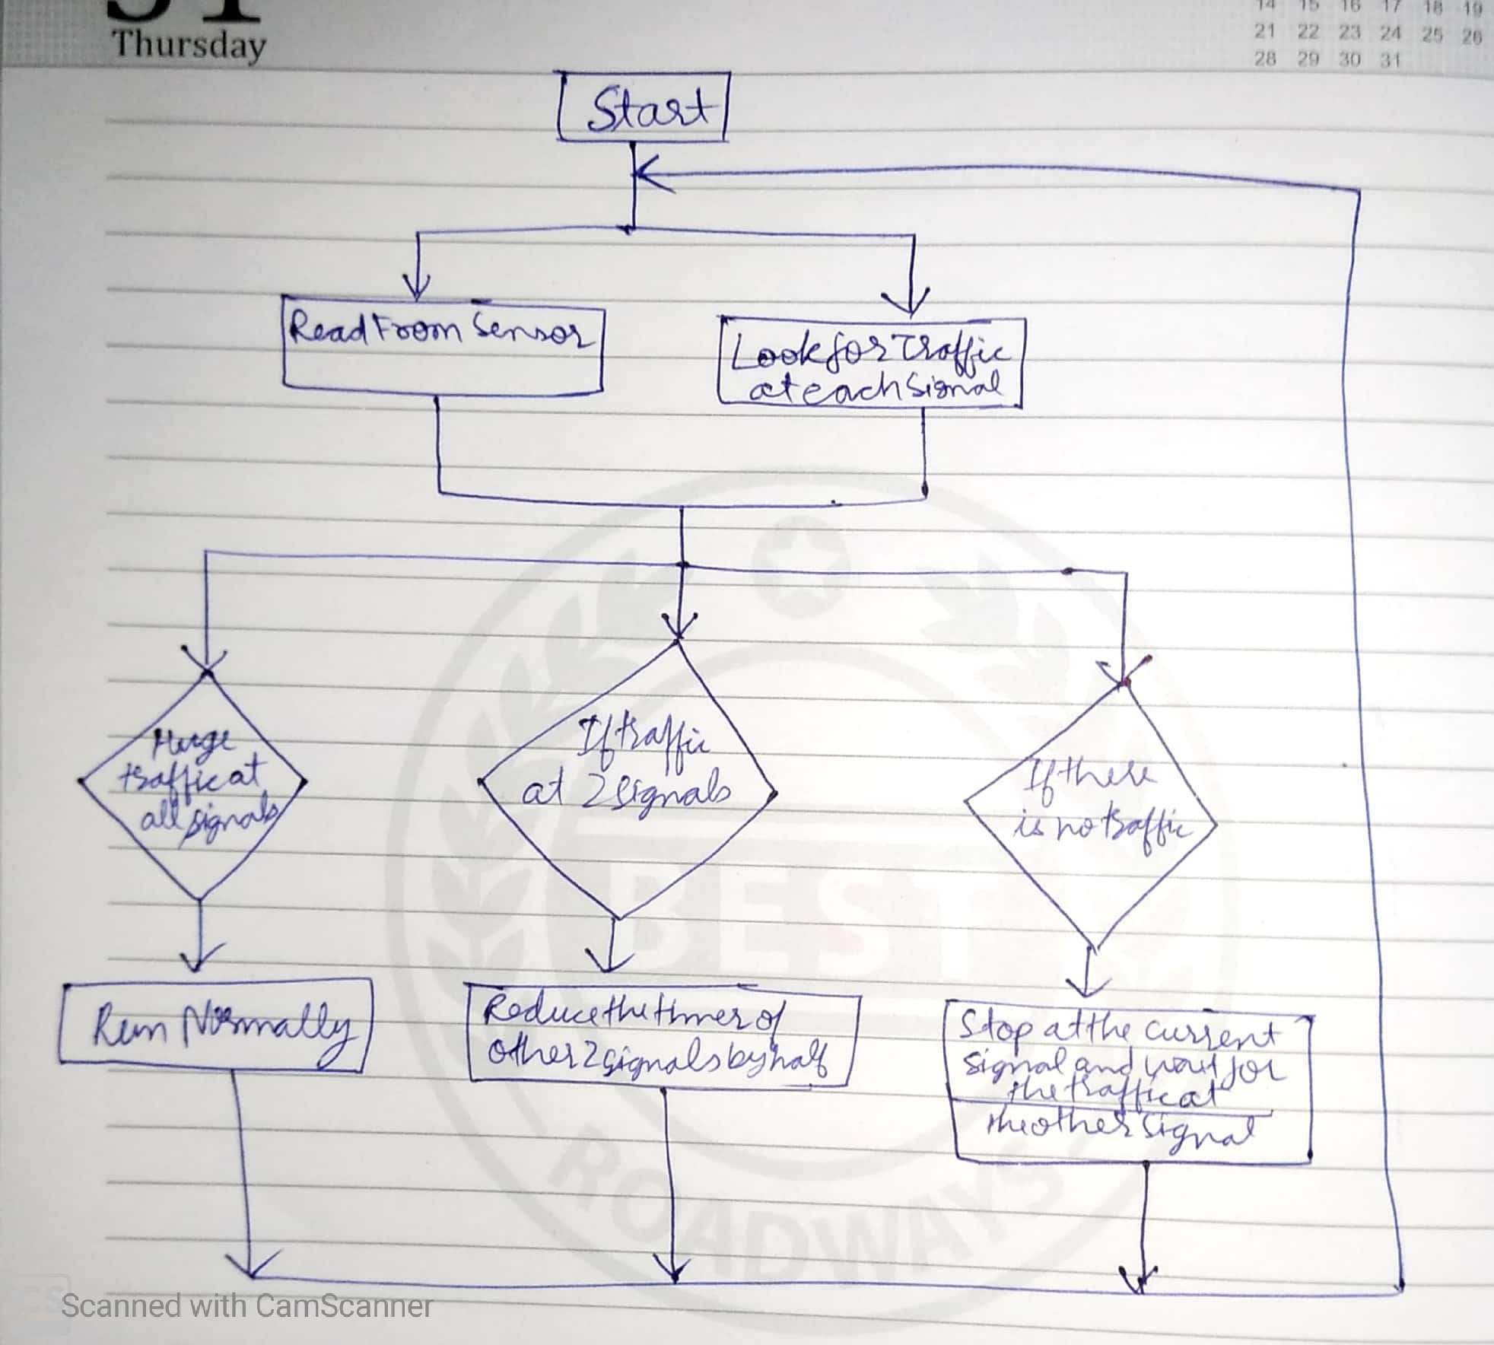
Flow Chart

Slide 7
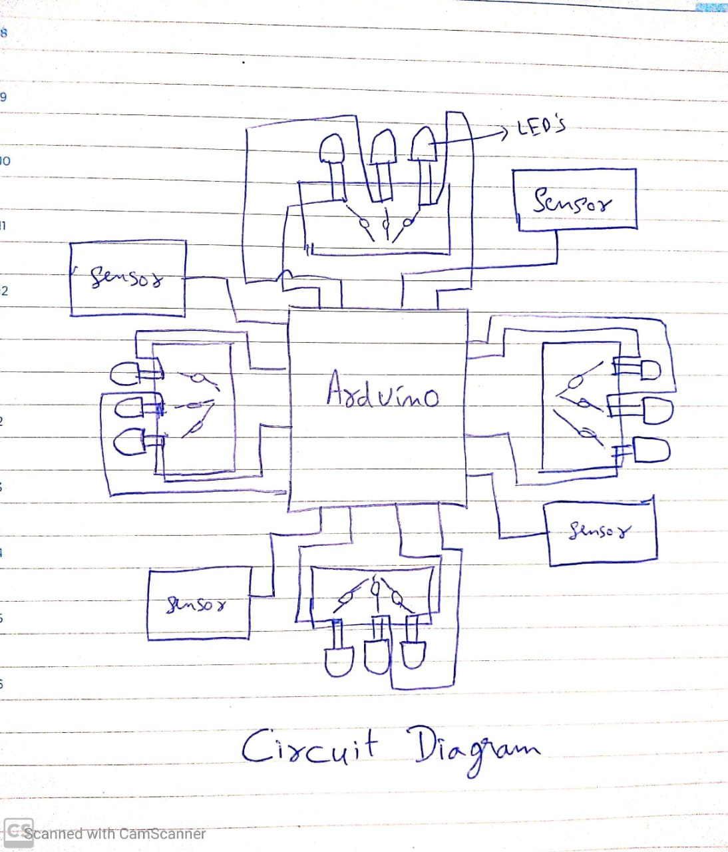
Circuit Diagram

Slide 8
Components Requirements :-
Arduino Mega
4 X Ultrasonic sensors
4 X Red LEDs
4 X Green LEDs
4 X Yellow LEDs
Resistors
Jumper cables
Breadboards

Slide 9
Ultrasonic sensor :-
Four ultrasonic sensors are interfaced with the Arduino. Arduino will read from these sensors and will calculate the distance. This sensor can measure from 2 to 400 cm.
LEDs :-
LED’s are connected to the Arduino through the 220 ohm resistors.

Slide 10
CONCLUSION
We have studied the optimization of traffic light controller in a city using Arduino and Ultrasonic Sensors. A traffic light system has been designed and developed with proper integration of both the hardware and the software.
This interface is synchronized with the whole process of the traffic system. Automatically, this project could be programmed in any way to control the traffic light model and will be useful for planning proper road system.

Slide 11
Reference
https://create.arduino.cc
https://www.google.com/search
https://www.youtube.com/watch

Slide 12
THANK YOU

